Slide 1
Faculty Senate Meeting
27 February 2024

Slide 2
Meeting procedure
Only Senators may debate motions
Only Senators can vote
If you are not a Senator, or a proxy, you cannot vote or debate
Do not speak over someone, or out of order
  Raise your hand (For those online please use “Raise Hand” on the Zoom app)
  The President will call on you and then you will have the floor
  Please wait for the microphone
Unless you have been recognized (told you have the floor), you may not speak

Slide 3
I. Call to order
D. Westenberg, President

Slide 4
II. Roll Call
J. Schlegel, Secretary

Slide 5
III. Consent Agenda
D. Westenberg

Slide 6
Consent Agenda
Approval of the 30 January 2025 minutes
Campus Curriculum Committee moves to approve CC and DC forms from their last meeting

Slide 7
IV. President’s Report
D. Westenberg

Slide 8
IFC - Next Meeting March 11
Topics to be presented
  IT/AI updates
  Government relations
  Impact of executive orders on budgets
Draft of a new Executive Order – Compliance with Law Enforcement Investigations
  Shared with Senators last week
  Formalizes existing guidance

Slide 9
Curators Meeting on Campus
April 17
  BioPlex Groundbreaking
  Recommend students for reception with Curators
  https://forms.office.com/r/JAdCrjMs27
    Will also email the link to Senators

Slide 10
Campus Matters
Provost search committee
  Good turnout for virtual open forum
  Ad is posted, submit recommendations
F&O General Listening sessions (virtual and in person)
  Schedule and topics on Percipio
  Next session – Construction Updates
    March 4 10 am (virtual), 1 pm (115 Innovation Lab)

Slide 11
Campus Matters
Leadership Meetings
  See Miner Momentum for topics discussed
  Concerns raised about dealing with executive orders and impact on budgets and campus mission
    We are doing the right things so keep doing what you are doing

Slide 12
Campus Matters
Other topics
  UG Enrollment is looking strong
  Week 5 reporting – reaching out if 2 or more flags
  Promoting Well-Being and Success
  Enrolling qualified non-thesis MS students – Q&A
  Shared Governance summit with chancellor, provost, COACHE committee, senate officers – This morning

Slide 13
Campus Matters
Things we are watching
  Open forums on new/revised Policy Memoranda
    Emeritus Office/Lab Policy
    Campus Closure Policy
    Qualifications for Academic Ranks – TP Referral

Slide 14
Campus Matters
Good News
  We Are R1!
  Men’s Basketball conference champions
  Women’s Basketball in conference championship
  Girl Scout Cookie Season

Slide 15


Slide 16
Be Involved
Be Engaged
Do Something

Slide 17
V. Campus Reports
A. Staff Council
K. Walkup

Slide 18
Giving Days
Posts Start Tomorrow! 2/19
Staff Council:
https://www.givecampus.com/7qzh16

Slide 19
Spring 2025 Staff Appreciation Day WEEK!!
Not finalized, but get excited!
Date: May 19-22, 2025 - Spirit Week
19 - TBD
20 - TBD
21 - Staff Day
22 - Mammogram Truck
Location: Innovation Lab
Theme: Game Show

Slide 20
V. Campus Reports
B. Student Council
M. De La Hunt

Slide 21
Update on Current Projects
Referendum next week!
  Voting and information tables starting tomorrow
  All current students may vote, regardless of year or hours enrolled
  Information is available at https://stuco.mst.edu/vote
    Please encourage students to check out that page!
Student Body President
  One candidate: Aiden Wallace Pickett
  Required to get 50% affirmative votes
Proposition A: Fee Increase
  Increase by $29 to $30 (pending inflation numbers)
  Supports major projects including hiring two new well-being staff and renovations to the rec center
  Approved by Student Council
Amendment 1: Constitutional Amendment
  Updates terms and makes various situational tweaks to the Constitution of Student Council

Slide 22
Update on Current Projects
Mental Health Initiatives
  Student Council and the Greek Life office holding RESPOND training. Stay tuned for details.
  Bill in progress to require RSOs to have an executive member responsible for Well-Being.
Academic Information Availability
  Mizzou Syllabus Bank passes their Faculty Senate equivalent (optional)
  Presentation drafting nearly complete, can be presented to FS if Officers would like
  Discussions held with other officers after last meeting
  See next slide for more details
We’ve been busy!
  8 Bills and 1 Resolution introduced by this point
  There will definitely be more

Slide 23
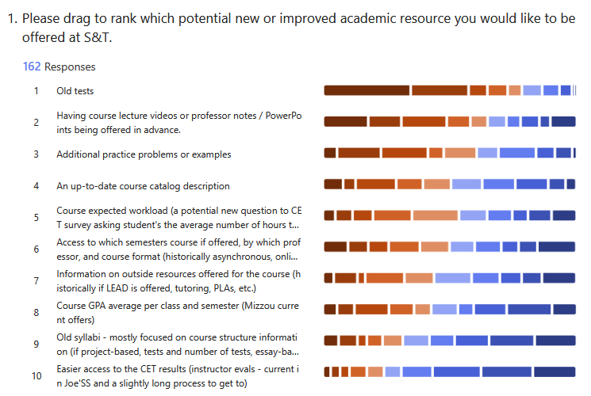

Academic Information Availability
Use this as a suggestion on resources to provide your students each semester!
Not all of these can be implemented via policy. We rely on all of you individually choosing to help out for our success.
This data will be back when Delaney Pipkin and I have a full presentation on this topic.

Slide 24
Points of Contact: Update
VP of Engagement and Outreach: Aiden Pickett
Public Relations Lead: Sydney DuBois (also SUB president)
  Please reach out to the two of them for publicity questions
Working with new Involvement Office Director: Josh Gruenke

Slide 25
Questions?
Contact Information
stuco@mst.edu
(573) 341-4280
Room 232, Havener Center
https://stuco.mst.edu
Office Hours available on our website
Martin De La Hunt
martin.delahunt@mst.edu

Slide 26
V. Campus Reports
C. Council of Graduate
Students

Slide 27
Council of Graduate Students
No report

Slide 28
VI. Special Topics
A. Financial Outlook
A. O’Neil
For more information:
Budget 101 & FY26 Outlook – April 2nd & 3rd

Slide 29
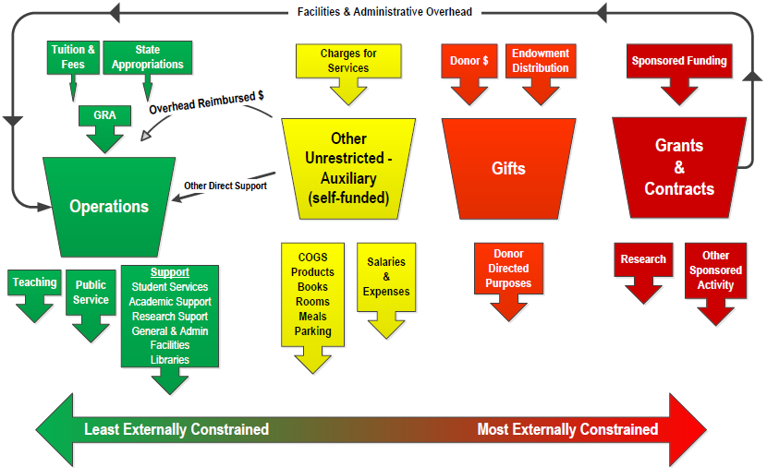

Funding Sources
FY25 Budget
Notes:
Scholarship allowance shifted down from reduction of revenue to be included in expenses
Source: WD B01 – original budget FY26 (adjusted for actual beginning balances)

Slide 30
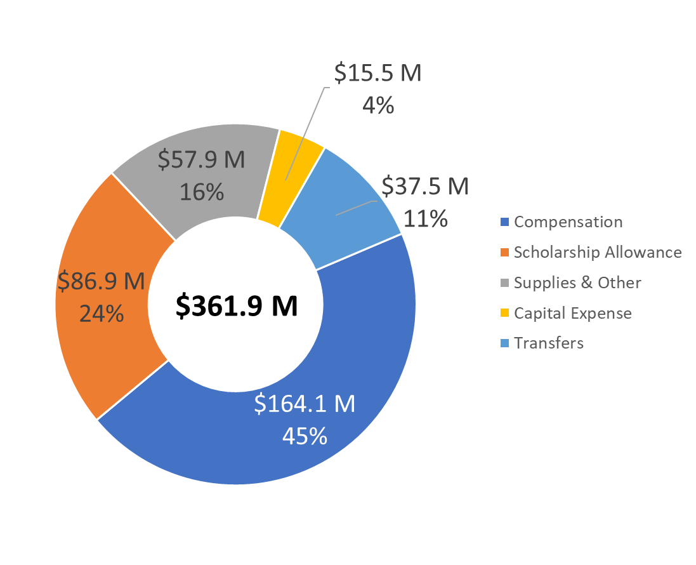
Budgeted Expenses
FY25 Budget

Slide 31
Operations Fund Sources
FY25 Budget

Slide 32
Operations Fund Expenses
FY25 Budget
$228.1 M

Slide 33
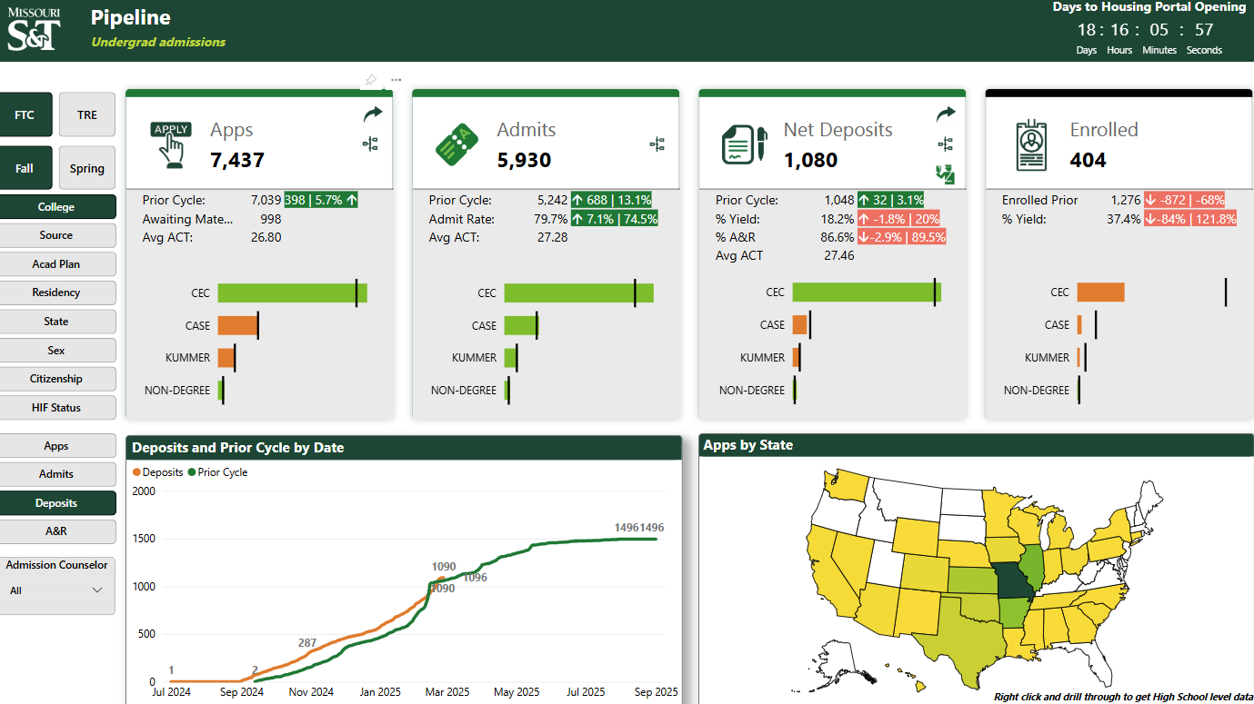
Enrollment Dashboard
As of 02/26/2025

Slide 34
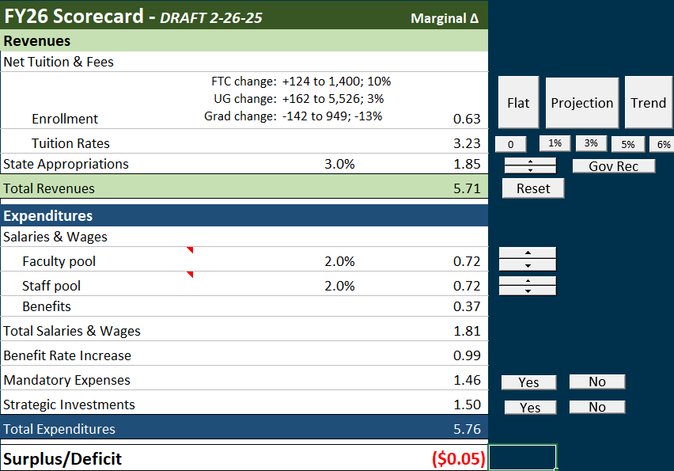
Draft scenario: FTC Goal, State up 3.0%
…as of 2-26-25
FTC: 10% increase
New Grad: 20% decrease
Tuition rates:
  5% Res UG
  3% all others
State: 3.0% increase
$1.8M set aside for merit

Slide 35
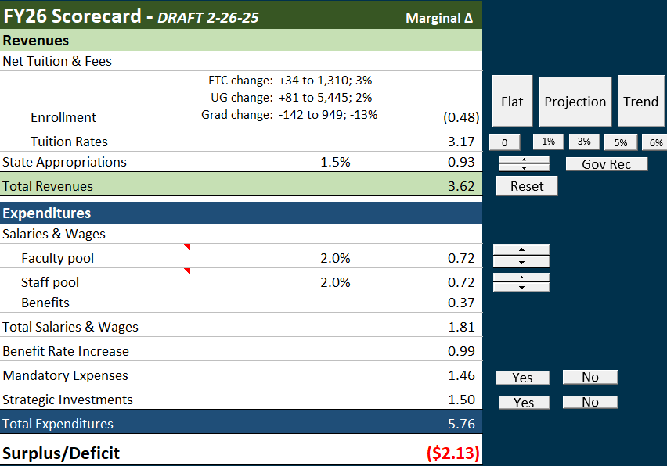
Draft scenario: Current FTC trend, State up 1.5%
…as of 2-26-25
FTC: 3% increase
New Grad: 20% decrease
Tuition rates:
  5% Res UG
  3% all others
State: 1.5% increase
$1.8M set aside for merit
$2M reallocation

Slide 36
Monitoring potential changes to Indirect
…impact of a proposed reduction to 15% recovery rate
Potential financial impact of proposed reduction to 15% recovery rate
  NIH Only: $80k – $250k
  NIH + DHHS: $780k - $1M
  All Federal Awards: $5M - $6M+
Campus leadership monitoring closely
  Indirect recovery allocation policy under review
  All costs funded “directly” by indirect under review
  VCR working with Center leaders and researchers to identify opportunities to increase revenue, reduce cost and shift more relevant costs from indirect to direct

Slide 37
Strategic Reallocation
Strategic Investment | Amount | SFA | Allocation Strategy | Committed
Faculty Start-up packages | 1,000,000 | 4 | Requests for start-ups are communicated by Deans and in-line with six strategic hiring focus areas. | $360,000
IT Research Infrastructure | 700,000 | 4 | Coordination b/n IT, VCR and Research Council to begin to address most critical needs to support research security/equipment/instruments | $700,000
Teaching Lab Equipment/Space Upgrades | 500,000 | 3 | HSS G5 & Emerson PLC OR Controls Sys Lab | $500,000
Space Utilization Strategy | 500,000 | 8 | Creation of swing space in Altman hall by moving coaches to Gale Bullman, improvements to BC | $500,000
High Traffic Space & Furniture Refresh | 412,000 | 8 | Focus on campus visit path, high student traffic areas – Toomey Hall, HSS, Eng Mgmt | $412,000
Supplement Core Instruction | 300,000 | 3 | Supplement to existing funding allocated by Provost in collaboration with Deans. Metrics include registration patterns, waitlist sizes, and justifications for course caps. | $300,000

Slide 38
Strategic Reallocation
Strategic Investment | Amount | SFA | Allocation Strategy | Committed
Student Success & Well-being Transition | 300,000 | 2 | Stellic software, Mentor Collective | $300,000
Online Education | 300,000 | 3 | Enhanced marketing efforts identified by VPOLEI in collaboration with Marketing and ENMG | $300,000
Research Equipment Maintenance | 300,000 | 4 | With consultation from Center Directors & Dept Chairs, allocation will be application based and capped per dept/URC for shared equipment | $300,000
Marketing & Communication - National Visibility | 250,000 | 5 | Markets selected based on consultation with ENMG and indicators reflecting regional momentum with the goals of enhancing and expanding that awareness and complementing ENMG efforts. | $250,000
Dual Career Hires | 200,000 | 7 | Supplement to existing resources & to create opportunities for dual hiring in general based on national best practices | $110,000
Business Intelligence/Process Improvement | 100,000 | 7 | Spending will largely depend on process, data, and reporting improvement needs of campus-wide strategies | $50,000

Slide 39
Missouri S&T Financial Outlook
Faculty Senate
February 27, 2025
For more information:
Budget 101 & FY26 Outlook – April 2nd & 3rd

Slide 40
VII. Committee Reports
A. Academic Freedom and Standards
L. Jiang

Slide 41
Test-Optional Admissions
Following discussion and a vote of AF&S, the committee moves that Faculty senate endorse continuation of test optional admission for one more year.

Slide 42
VII. Committee Reports
B. Budgetary Affairs
B. Lea

Slide 43
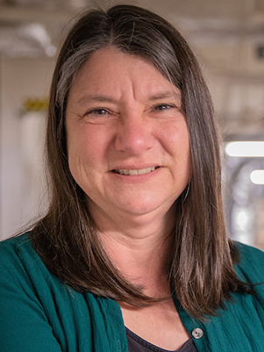
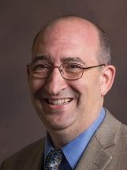
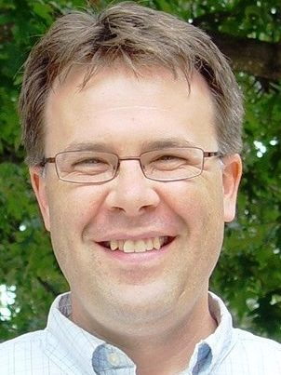
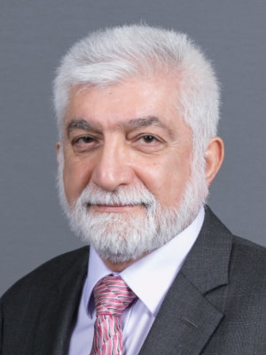
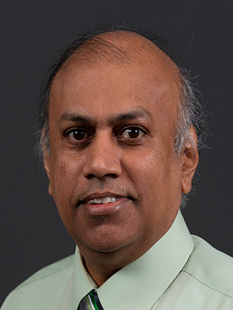
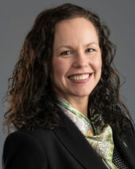
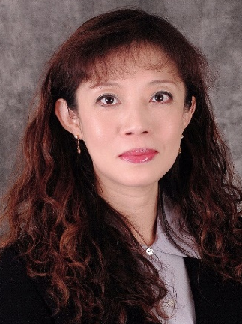
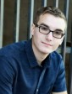
Budgetary Affairs Committee (BAC)
2-27-2024 Report
Special Topics “VCFO Budget Updates”
Emerging Issues & Referrals
  IT Budget at UM Campuses
  FY 24 F&A Distribution for Negotiated Rate Portion
  Grad Research Assistant In-State Tuition Funding by Source
  Bookstore RFP
  On-going
Financial Position
Dr. Melanie Mormile mmormile@mst.edu
CASE
Dr. David Bayless dbayless@mst.edu
CEC
Dr. Kelly Homan khoman@mst.edu
CEC
Dr. Ali Hurson hurson@mst.edu
CEC
Dr. Jag Sarangapani sarangap@mst.edu
CEC
CFO Alysha O'Neil alysha.oneil@mst.edu
Finance & Operations
Dr. Bih-Ru Lea (Chair) leabi@mst.edu
Kummer College
Mr. Logan Garton wgcf2@mst.edu
Student Council, Civil Eng

Slide 44
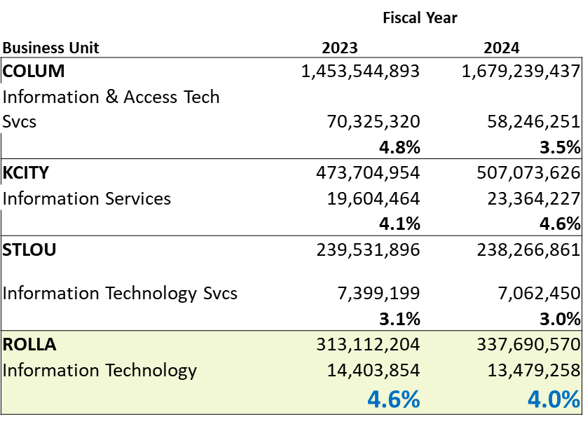
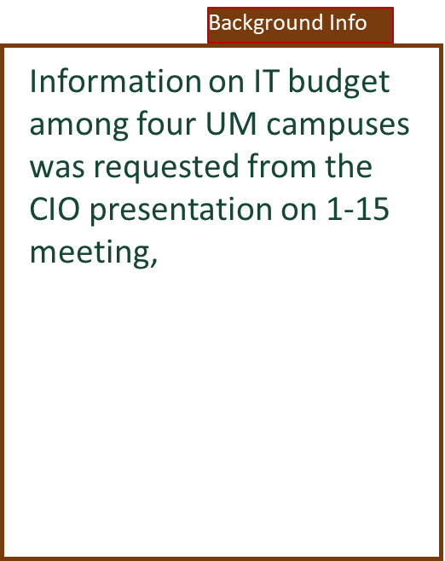
Referral 1: IT Budget Comparison at UM Campuses

Slide 45
Referral 2: FY2024 F&A Distribution for Negotiated Rate Portion
Background Info
The following policy is to be used to distribute the “negotiated rate” portion of the indirect cost funds recovered from grant and contract expenditures (see Policy Memorandum III-30).
From the CIO presentation on the 1-15 meeting, the BAC Committee suggested to Mr. Barry Robins
… Collaborate with the Office of Sponsored Programs (OSP) and S&T Research Centers to identify and leverage external funding opportunities, such as incorporating IT-related costs (e.g., computing resources) and overhead recovery rates in grant proposals…
Distribution of the indirect cost funds will be as follows:
 | Vice Chancellor for Research 70%
 | College 20%
 | Library journal subscriptions 2%
 | Physical Facilities for Research M&R 8%
Continuous Improvement Process
Information requested by a Faculty Search Committee Meeting
NSF Implementation of Recent Executive Orders
Notes:
https://www.nsf.gov/executive-orders#faq1

Slide 46
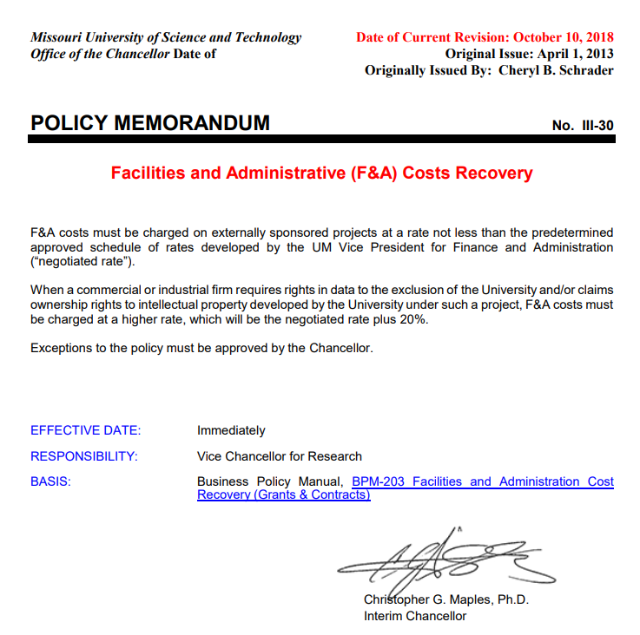
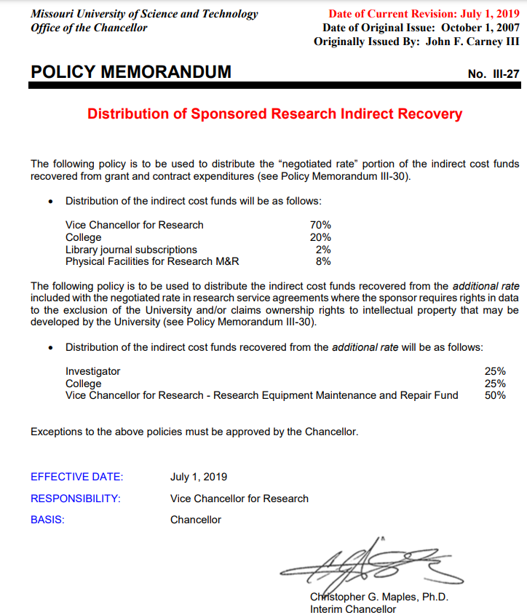
Notes:
https://chancellor.mst.edu/media/administrative/chancellor/documents/policy/III-30%20October%202018%20(003).pdf
https://chancellor.mst.edu/media/administrative/chancellor/documents/policy/070119ResearchIndirectRecovery.pdf

Slide 47
Referral 2: FY2024 F&A Distribution for Negotiated Rate Portion
BAC referred this issue to DCC for feedback to VCFO
Feedback Request
Vice Chancellor for Research 70% | $ 7,052,119 | 70.00%
College 20%
College Arts, Science, Education | $ 298,915 | 2.97%
College Engr & Computing | $ 1,657,744 | 16.45%
Enrollment Management | $ 4,376 | 0.04%
Kummer College | $ 46,448 | 0.46%
Provost Office | $ 6,660 | 0.07%
Research & Innovation | $ 748 | 0.01%
Library journal subscriptions 2% | $ 201,489 | 2.00%
Physical Facilities for Research M&R 8% | $ 805,957 | 8.00%
 | $ 10,074,456 | 100.00%
Feedback on the distribution framework to VCFO Ms. Alysha O’Neil
Should IT modernization be part of the distribution framework?
Should the distribution framework be considered with the strategic budget reallocation?
Notes:
BAC ask for more details on how the 70% were allocated and carryover each year → in respect to sustaining various research centers

Slide 48
Referral 3: Grad Research Asst In-State Tuition Funding by Source
Grad Research Asst In-State Tuition Funding by Source
Start Up | $ 230,524 | 5.7%
Faculty Support | $ 28,050 | 0.7%
Internal Research Awards & Research Boards | $ 20,350 | 0.5%
Dept Discretionary | $ 308,042 | 7.6%
F&A Dist | $ 27,988 | 0.7%
Kummer | $ 236,081 | 5.8%
Endowments | $ 148,463 | 3.7%
Gifts | $ 130,950 | 3.2%
Grants & Contracts | $ 2,922,596 | 72.1%
AY23-24 Total | $ 4,053,043 | 100.0%
Background Info
In the 1-15 meeting, graduate research assistant in-state tuition funding by the source was requested as the committee reviews the referral item Information Items – Net Tuition Revenue per Student (Appendix 1 or 1-31 FS Slides)
NSF Implementation of Recent Executive Orders

Slide 49
Turning operating loss into revenue
Referral 4: Bookstore RFP
Background Info
Finalists
Akademos
(Vital Source)
Barnes & Noble
Follett
Tentative Timeline
From VCFO
RFP for a new vendor to run the Bookstore.
S&T has been collaborating with the Mizzou store leadership throughout the process.
The S&T store has been operated by leadership at Mizzou for many years, but we've decided it's time to see what others may be able to offer.
If it doesn't work out, the Mizzou store will continue to serve our needs.
RFP Issue Date | Jan 06, 2025
Question Submission Deadline | Jan 20, 2025
RFP Response Deadline | Jan 29, 2025
Site Visits | Jan 13-17, 2025
Review Process Kickoff | Jan 30, 2025
1st Committee Meeting Tentatively | Feb 06 - 14, 2025
On-Site/Online Vendor Presentations | Feb 17- 21, 2025
2nd Committee Meeting Tentatively | Feb 24, 2025
Possible Committee Meeting 1hr Time Blocks for contract negotiations and award. | Feb 28, 2025 March 4, 11, 18, 25, 2025
Contract Award Tentatively | Apr 4 - 11, 2025
Vendor Set up time 10-12 weeks
Opening July or August 2025
Committee Members
Saadiya Fratila
Sarah Frost
Bella Gerlich
Robin Gore
Chang-Soo Kim
Bih-Ru Lea (BAC Rep.)
Alysha O’Neil
Barry Robbins
Xavier Ross
Reagan Thornton
Teresa Vest

Slide 50
Financial Position Update
A Look Ahead…
  Scheduled for the 3-5 BAC meeting
    VCFO to review and provide updates on 10% Budget Reallocation
    VCFO to share information on salary trends between faculty and administrative personal
    Program Health BI Reporting
  VCFO’s 10% Budget Reallocation Update is scheduled as a special topic report for the 3-20 FS meeting
  VCFO S&T: FY25 Financial Update and FY26 Look Ahead on April 2 (in-person) and April 3 (online) (Appendix 2)
  On-going Discussions on Reporting Format
    The BAC is reviewing the reporting and will provide feedback to VCFO
2-27-2025 Report
Refer to VCFO Special topics “Budget Update”
Enrollment Trends Update
Financial Position

Slide 51
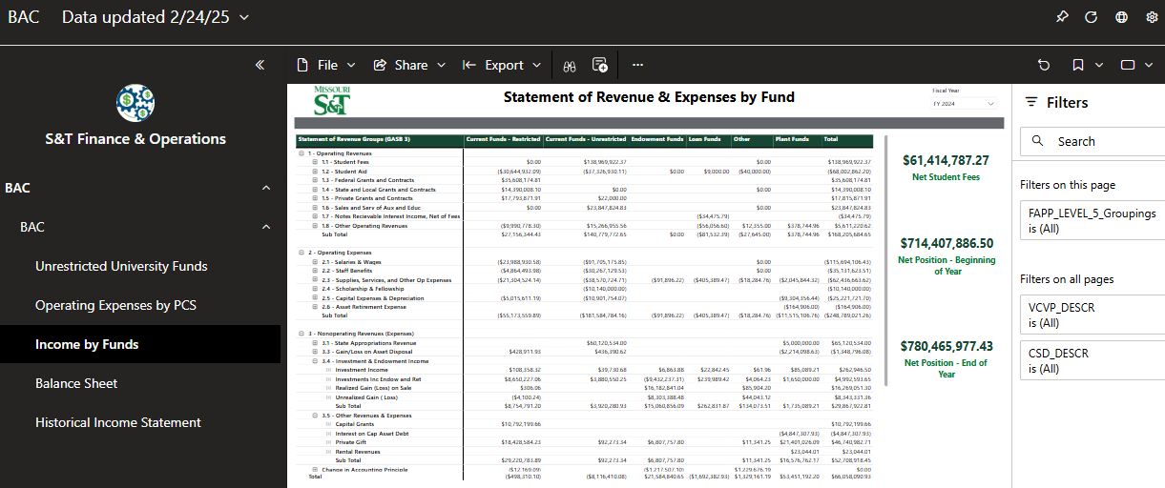
Look Ahead: BAC Reporting Format on Financial Positions

Slide 52
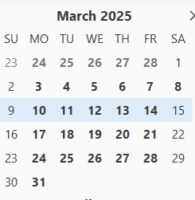
Information: Next Topic Request Due Date: 11:59 pm, 3-3-2025
All topics or questions submitted by March 3 will be reviewed at the March 5 BAC meeting, where the BAC will assess the following
  urgencies and priorities of topics/questions
  data collection timeline
  Approach(es) to addressing each topic
  communication plans
Findings will then be communicated to the faculty during the March 20 Faculty Senate meeting, another future meeting, or an appropriate communication channel.
Faculty Senates Meeting
Budgetary Affair Meeting
RP&A Meeting
DCC Meeting

Slide 53
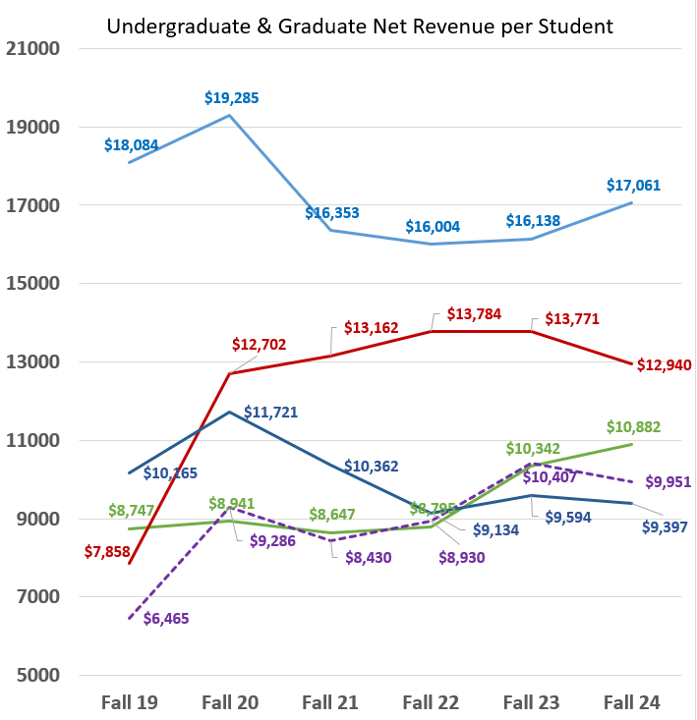
Appendix 1
Net Revenue per Student
Net Tuition Revenue per student
(highest → Lowest)
UG–non-Resident
Main campus - UG – non-Resident
Main campus - G – non-Resident
G – non-Resident
Main campus - UG - Resident
UG - Resident
G - Resident
Main campus - G - Resident
Distance - G
G - Distance
Source: DCC Tuition Data-FY25 Budget-Nov update.xlsx
Notes:
Source: DCC Tuition Data-FY25 Budget-Nov update.xlsx

Slide 54
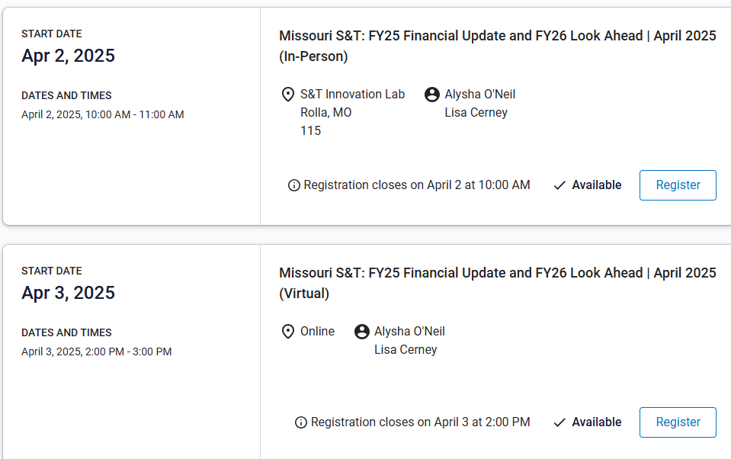
Appendix 2
https://umsystem.percipio.com/liveCourse/acde9090-6a38-42ff-b25a-944d13cf1d88
Notes:
https://umsystem.percipio.com/liveCourse/acde9090-6a38-42ff-b25a-944d13cf1d88

Slide 55
VII. Committee Reports
C. Campus Curricula
P. DeWitt

Slide 56
General Education
A vote on the General Education policy approved by the Campus Curricula Committee will take place at the next Faculty Senate meeting.

Slide 57
VII. Committee Reports
D. Information Technology
D. Stutts

Slide 58
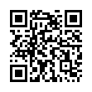
ITCC Meeting on February 7, 2025
  Approved minutes from the meeting on January 23, 2025
Discussed the creation of a survey of IT performance (subcommittee headed by Dr. Zawodniok).
  Survey published on February 25, 2025.
    Emails sent to faculty and staff
    Link: https://mst.qualtrics.com/jfe/form/SV_e3rQr9dCkuKV8Fg
    Survey ends on March 21 (Friday)
    Report from survey will be presented afterwards
  ITCC plans to repeat survey twice a year to track
  progress and update goals for IT/ITCC

Slide 59
VII. Committee Reports
E. Public Occasions
A. Behrendt

Slide 60
Public Occasions Committee Motion
The Public Occasions committee moves to adopt the following dates and events to the 2025-2026 academic calendar:
  Homecoming will be October 3-4, 2025;
  Open Houses will be held on October 18 and November 1, 2025 and February 16 and April 3, 2026.

Slide 61
VII. Committee Reports
F. Rules, Procedures, &
Agenda
K. Dolan

Slide 62
Administrative Review
Since Steve Roberts’s duties as the Vice Chancellor of Strategic Initiatives have changed significantly in the past year, the RP&A Committee moves that Steve Roberts be removed from the list of administrators to be reviewed by the Administrative Review Committee.

Slide 63
VIII. Unfinished Business
D. Westenberg

Slide 64
IX. New Business
D. Westenberg

Slide 65
X. Q&A with the Provost
C. Potts, Provost

Slide 66
XI. Announcements
D. Westenberg

Slide 67
XII. Adjourn

Slide 68
Thank You
D. Westenberg
President, Faculty Senate
djwesten@mst.edu
facultysenate.mst.edu

